Slide 1
HINGHAM PUBLIC SCHOOLS
FY 2014 OPERATING AND CAPITAL BUDGET RECOMMENDATIONS
February 11, 2013
PUBLIC HEARING

Slide 2
WHAT IS A “NEEDS - BASED” BUDGET?
A proposal from the administration to the SC that reflects needs and priorities as identified by Principals, Directors, and Central Office
One that includes costs that are known or projected based upon current information
One that results from enrollment increases or new or emerging needs or a backlog of needs reflecting prior cuts or underfunding
The beginning of the conversation

Slide 3
STEPS IN THE BUDGET PROCESS
School Committee Planning Session – September 2012
Adoption of budget guidelines and assumptions by SC
Solicitation of input from staff (needs and challenges)
Review of challenges (backlog of unmet needs, student and family needs, unfunded mandates, etc. )
Review of staff requests (principals and directors)
Prioritizing of requests and development of initial budget by admin.
Refinement of administrator-proposed budget as additional information emerges (ongoing throughout the process)
School Committee review, comments, and initial priorities
SC Adoption of its budgets following Public Hearing
Selectmen and Ad Com Recommendation on School Budgets to TM
Town Meeting Action on all Town Budgets

Slide 4
 |  |  | Original |  | Adjusted
 |  | Budget | Budget | Adjustment | Budget | Increase
ACCOUNT | ACCOUNT TITLE | 2012-2013 | 2013-2014 | 31-Jan-13 | 24-Jan-14 | (Decrease)
1100 | School Committee | $45,850 | $46,850 |  | $46,850 | $1,000
1200 | Administration | $846,853 | $867,955 |  | $867,955 | $21,102
2200 | Principals | $1,760,477 | $1,965,454 |  | $1,965,454 | $204,977
2300 | Teaching | $18,645,917 | $19,751,827 | -$255,599 | $19,496,228 | $850,311
2350 | Professional Development | $185,100 | $187,000 |  | $187,000 | $1,900
2400 | Textbooks | $237,137 | $264,066 |  | $264,066 | $26,929
2410 | Instructional Equipment | $11,500 | $22,700 |  | $22,700 | $11,200
2450 | Instructional Technology | $585,947 | $672,780 |  | $672,780 | $86,833
2500 | Library | $537,159 | $630,498 | -$32,171 | $598,327 | $61,168
2700 | Counseling | $876,234 | $952,457 |  | $952,457 | $76,223
2800 | Psychological Services | $329,464 | $339,448 |  | $339,448 | $9,983
3200 | Health Services | $477,485 | $492,100 |  | $492,100 | $14,615
3300 | Transportation | $1,236,613 | $1,286,998 |  | $1,286,998 | $50,384
3510 | Athletics | $595,919 | $595,890 | -$1,833 | $594,057 | ($1,862)
3520 | Other Student Activity | $94,706 | $103,041 |  | $103,041 | $8,335
4110 | Custodial | $1,329,369 | $1,417,918 |  | $1,417,918 | $88,549
4120 | Heating of Buildings | $458,369 | $392,002 | $31,704 | $423,706 | ($34,663)
4130 | Utilities | $732,145 | $749,943 | -$25,610 | $724,333 | ($7,812)
4210 | Maintenance of Grounds | $13,478 | $27,108 |  | $27,108 | $13,630
4220 | Plant Maintenance | $718,640 | $751,126 |  | $751,126 | $32,487
4230 | Repairs of Equipment | $107,370 | $106,053 |  | $106,053 | ($1,317)
5100 | Employee Retirement | $75,792 | $29,231 | $32,350 | $61,581 | ($14,211)
7000 | Non-Instructional Equipment | 0 | 0 |  | $0 | $0
 | Allowance for increases | $21,671 | $215,736 |  | $215,736 | $194,065
 | Total Regular Education | $29,923,194 | $31,868,180 | -$251,159 | $31,617,021 | $1,693,826 | 5.66%

Slide 6
FY 2014 ADMINISTRATION - PROPOSED BUDGET
“AT A GLANCE”
Combined Budgets $42,568,038
( + 4.93 % from FY ’13)
Regular Education $31,864,872
( + 6.49 % from FY ‘13)
Special Education $10,564,875
( + 0.63 % from FY ‘13)
Vocational Education $138,292
( - 4.96 % from FY ’13)
Initial Request
Dec. 2012

Slide 7
FY 2014 ADMINISTRATION’S PROPOSED BUDGET
“AT A GLANCE” – 1/24/13 Revision
Regular Education $31,864,872 $31,755,597
( + 6.49 % + 6.12% from FY ‘13)
Special Education $10,564,875 $10,410,115
( + 0.63 % - 0.84% from FY ‘13)
Vocational Education $138,292 (no change)
( - 4.96 % from FY ’13)
Com
Combined Budgets $42,568,038 $42,304,003
( + 4.93 % + 4.28% from FY ’13)

Slide 8
FY 2014 ADMINISTRATION - PROPOSED BUDGET
“AT A GLANCE”
Combined Budgets $42,224,716
( + 4.09 % from FY ’13)
Regular Education $31,676,310
( +5.86% from FY ‘13)
Special Education $10,410,115
( - .84% % from FY ‘13)
Vocational Education $138,292
( - 4.96 % from FY ’13)
January 31 Revision
( - $79,287)

Slide 9
FY 2014 ADMINISTRATION - PROPOSED BUDGET
“AT A GLANCE”
Combined Budgets $42,165,427
( + 3.94% from FY ’13)
Regular Education $31,617,021
( +5.66% from FY ‘13)
Special Education $10,410,115
( - .84% % from FY ‘13)
Vocational Education $138,292
( - 4.96 % from FY ’13)
February 11
Revision
( - $59,289)

Slide 10
CHANGES TO ADMINISTRATION’S PROPOSED FY 14 BUDGET as of 2/11/2013
Personnel changes – 9 retirements, 1 LOA, other adjustments - $255,599
2500 Cable offset, HS para hrs. career center (-5) and library (-13) - $32,171
3510 Error correction - $1,833
4120 Increased building rental (15K) and KIA (10K) offsets - $25,000
4120 Increased natural gas (18,801) and oil (37,903) heating + $57,314
4130 Electricity price reduction - $25,610
5100 Adjusted retirement costs + $32,350
2100B Adjusted legal - $10,000
9100B reduce one anticipated tuition and one anticipated grad. - $144,760
Total Reduced $405,919

Slide 12
376
356
342
333
319
297

Slide 13
K – 12 Projections for September 2014 (based on moving along December 2012 actuals)
Grades K – 5
2041 -339 (to gr. 6) + 256 (new K) + 60 (grade K to 1 growth) = 2018
Down 23, plus net in/out migration
Grades 6-8
974 - 316 (to HS) + 339 (from grade 5) = 997
Up 23, plus net in/out migration
Grades 9-12
1127 + 316 (from grade 8) – 276 (graduates) = 1167
Up 40, plus net in/out migration
Projections assume no net in/out-migration, so are conservative based upon past practice of at least some net increases.
4182
PROJECTED
K-12 TOTAL
Notes:
OUR INTERNAL PROJECTS FOR EACH BUDGET YEAR FOLLOW A SIMPLE STRATEGY.
PROJECT K NUMBER,
PROJECT INCREASE TO GRADE 1,
AND MOVE EVERYONE ELSE ALONG (all real kids).
ASSUME, BUT DO NOT QUANTIFY IN AND OUT MIGRATION
LAST 3 YEARS, GRADE K TO 1 HAS AVERAGED MORE THAN 40

Slide 14
FY 14 Budget Budget Offsets (Gross and Net Budgets) Based on Initial December Budget

Slide 15
Enrollment Related Requests Requests reflect both anticipated enrollment for September 2013 and underfunding of prior year needs as enrollments have grown.
1.0 K-5 teacher $51,583
4.0 gr. 7-12 teachers (core
subjects and electives) $231,572
additional bus and driver $46,809
assistant X-country coach $1,623
assistant sailing coach $1,623
Total in Enrollment Related = $333,210

Slide 16
Restoration of Needed Positions or Services
These roles and services existed formerly, but have been cut or reduced over the past 5 years (some when the proposed operating budget override request was reduced in Spring 2009). Positions are necessary to the effective and efficient operation of the schools; enrollment and other needs have increased since 2009.
0.5 middle school librarian $30,302
1.0 middle school technology specialist $56,107
0.6 K-12 mathematics director (full time) $61,849
2.0 elementary assistant principals $190,332

Slide 17
(restoration continued)
1.0 PRS special education $61,034
1.0 custod./mainten. support/supervisor $65,000
3 additional college helpers for summer mainten./custodial work $12,650
30 25 hrs./wk. for the high school postsecondary support center $18,348 $15,290
Total: Restoration category = $495,622 $492,564

Slide 18
Areas of Unique Need Includes responding to: state and federal mandates, changing student demographics, and social/emotional and health needs
Central office -.5 clerical support $14,611
Transition room tutor (27.5/wk) $27,723
HS health aide increase (+ 5hrs/wk) $3,058
Algebra II support – teacher stipends $2,400
Title IX clerical support $3,000
Title IX dance team coaches $3,108
Total in Unique Need category $53,900

Slide 19
Areas of Unique Need Includes responding to: state and federal mandates, changing student demographics, and social/emotional and health needs
Central office -.5 clerical support $14,611
Transition room tutor (27.5/wk) $27,723
HS health aide increase (+ 5hrs/wk) $3,058
Algebra II support – teacher stipends $2,400
Title IX clerical support $3,000
Title IX dance team coaches $3,108
Total in Unique Need category $53,900

Slide 20
Initiatives to Enhance Programs These resources are needed to incorporate pilot programs and to provide better support for existing programs and facilities.
HS Global Citizenship Program
leader and advisor stipends (prior HEF funding) $6,200
Freshman Advisory program
teacher advisor stipends (prior volunteer) $7,585
HS Language Lab
lab aide hours (+ 5 hrs/wk) $3,058
General equip., copier, maintenance
increased funding levels $27,000
Total in Enhanced Programs category = $43,843

Slide 22
Justified Needs, but NOT in Proposed Budget at this time
Restoration of 2.25 MS and elem. adjustment counselors ($142,768)
Additional 1.0 elem. teacher to mitigate large class sizes ($53,806)
Additional aide/para hrs (each 7.5/wk): HS health room and lang. lab ($4,587)
0.6 elementary reading evaluator ($51,748)
Additional tutor hours (7.5/wk) for transitional room program ($5,545)
Text, instruct. materials, equip., mainten. projects
($100K estimate)
Total: requests not included ($358,484)
Notes:
THESE ARE REASONABLE REQUESTS!!!!!
THE SC IS ASKED TO LOOK ESPECIALLY AT THEM!!
THE FILTER HERE IS WHAT IS NEEDED, WHICH MAY NOT ALWAYS BE WHAT IS AFFORDABLE. WE DO UNDERSTAND THAT!!!
2 APS
ROUTINE SCHOOL MANAGEMENT
NEEDED FOR UPCOMING EVAL
BENEFIT IN SPED MEETINGS AND PARENT MEETINGS
INCREASING MANDATES SUCH AS COMMON CORE, BULLYING, ETC.

Slide 25
SPECIAL EDUCATION ENROLLMENT January 2013 “Snapshot”
By Level (In + Out of District)
By Building
Pre-K 35 + 2
Elem. K-5 211 + 16 + (1#)
MS 6-8 150 + 15 + (2#)
HS 9-12+ 152 + 29 + (3#)
TOTALS 548 + 62 + (6#)
610
# NON-SPED PRIVATE SCHOOL, BUT SERVICE ELIGIBLE
EAST 60 K-5 + 35 PK
FOSTER 55 K-5
PRS 54 K-5
SOUTH 42 K-5
MS 150 6-8
HS 147+5 9-12+
TOTAL 548

Slide 27
Out of District *Tuitions (2013-2014, projected for 64 students)
Type of School
*Tuition Range
Private Day Schools (12)
Private Residential Schools (11)
SEIS (Public) Residential (2)
Other Public Schools (5)
South Shore Educ. Collab. (26)
Other Local Collaboratives (10)
*Tuitions include known increases and projections for OSD requested increases. Some tuitions are for year-round services.
$ 40,492 to $ 106,000
$ 69,812 to $ 213,570
Deducted from Chapter 70
$ 32,270 to $ 42,700
$ 32,270 to $ 56,120
$ 29,750 to $ 56,650
SEIS - Special Education in Institutional Settings(add’ services only)
OSD – Operational Services Division

Slide 28
NEWER $$$ MANDATES: The “Heavy Hitters”
HB# 4307 Background Checks: FINGERPRINTING of EDUCATORS
Sept ‘13 – ’15 Recordkeeping and process costs ($35 -$55 per educator)
C.222 - Acts of 2012 School Discipline: ACCESS FOR EXCLUDED STUDENTS
July 2014 Tutoring?, e- courses?, OoD placement?, alternative programs? – Increased planning and support activities for counselors and administrators
PARCC ASSESSMENT Online Testing: SUCCESSOR TESTING TO MA MCAS
Spring 2015 Costs of enhanced technology resources (computers,
(initial testing) Internet access, band width, headsets and microphones)
DESE/RETELL Licensure Endorsements: SEI TRAINING FOR TEACHERS
thru 2016 & SUPERVISORS of ELL (English Language Learner) STUDENTS (staggered) Costs related to mandated training and eligibility changes
Other Potential Costs: Title IX Compliance, Coordinated Program Review Compliance, Additional school security measures, etc.

Slide 29
STRATEGIES FOR SAVINGS AND EFFICIENCIES
Strategy
Impact
Lease vs purchase of copiers
Electronic school to home communication
Recycling and composting efforts
Direct deposit and “paperless payroll”
initiatives
Revised ordering protocols (school-based)
Standardizing para services across schools
Energy reduction and management projects
Savings in maintenance costs, less “down” time
Savings in paper, production and distribution of paper copy
Reduction in disposal costs and some revenue production
Better use of personnel, printing savings, more accurate reporting and recording
Reduced potential for overstocking, better inventory control
Savings in para hours/$ in regular education
Energy/$ savings in capital and in operating budgets

Slide 30
STRATEGIES FOR SAVINGS AND EFFICIENCIES
Strategy
Impact
Develop. of new ways to provide FAPE in- district such as thru new cohort groups, transition services etc.
Review of contracts for specialized services to negotiate better rates for special education services
“Cross training” of C.O. clerical staff
Minimizing hiring of substitutes for support roles, where possible
Cost savings and children served in least restrictive settings (ex.” in-district” intensive K and PK programs and return of OoD students to HPS)
Cost savings and improved service quality
Better management of resources to meet new demands and consistent coverage during times of absence
Cost savings

Slide 31
FY 2014 ADMINISTRATION - PROPOSED BUDGET
“AT A GLANCE”
Combined Budgets $42,165,427
( + 3.94% from FY ’13)
Regular Education $31,617,021
( +5.66% from FY ‘13)
Special Education $10,410,115
( - .84% % from FY ‘13)
Vocational Education $138,292
( - 4.96 % from FY ’13)
February 11
Revision
( - $59,289)

Slide 32
FY 14 SCHOOL CAPITAL REQUEST (work in progress)
Capital Outlay Request – School Needs
January 9, 2013 $1,267,074
Redistributed and Reduced – School Committee Meeting
January 24 $790,334
Further Redistributed/Refined/Reduced –Long Range Planning Sub Committee
January 30 $660,734
Capital Outlay Meeting – Second review
February 6 - $110,000 ??

Slide 33
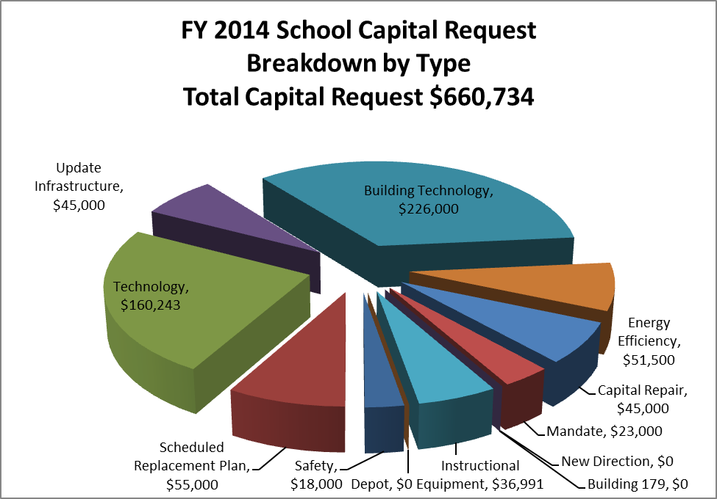

Slide 34
NEXT STEPS in S.C. PROCESS
School Committee adoption of its budgets operating and capital (February 25)
Education Subcommittee recommends School Budget to Ad Com (February 26)
AdCom vote on budgets to be recommended to Town Meeting (February 28)
Selectmen vote on budget to be recommended to
Town Meeting (TBD)
Town Meeting vote on Article 6 -Town Budgets
(April 22) YEAH!!!!!!
Notes:
LOT TO DO IN SHORT TIME!!!!!
COUPLE OF OTHER ANTICIPATED MEETINGS (ADCOM SUBCOMMITTEE) NOT YET ON THE SCHEDULE
INFO ON WHICH FUNCTIONS ARE SCHEDUED ON WHICH THURSDAY IS IN YOUR PACKET

