Slide 1
Hingham Public Schools
Foster Elementary School
Recommendation to File a Statement of Interest with the Massachusetts School Building Authority (MSBA) and Associated Articles for Town Meeting
Presented February 27, 2017

Slide 2
Foster Background
Elementary School Grades K-5
October 1, 2016 Enrollment 470 students
Built in 1951
Addition in 1957
Renovation 1974
Renovation 2008
Approximately 74,600 Square Feet
39.6 Acres
Steam boilers and infrastructure for heat

Slide 3
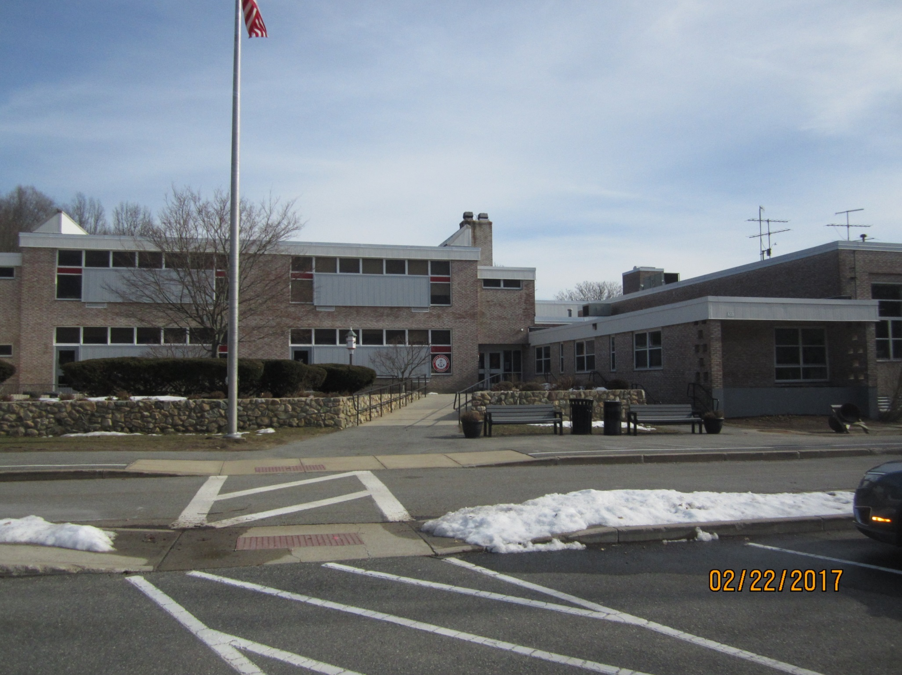

Slide 5
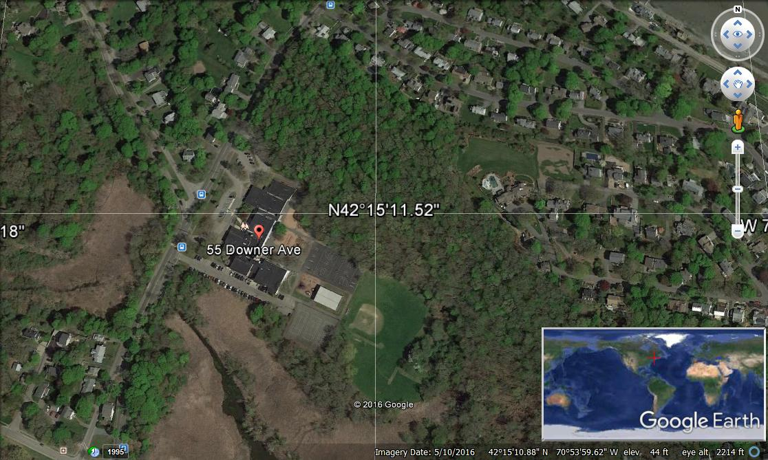

Slide 6

Primary Concerns with Foster
Building is clean, safe and well maintained
Excellent staff and maintenance very responsive
Building problems are a true inconvenience for the students, staff and the administration
  Foster has been fortunate to date in not losing school days. Winter weather over the past two years has been OK…
Heat, Electrical and Water Systems have been failing and at risk of further failure

Slide 7
Primary Concerns with Foster
Heating System
  Steam Plant has experienced failing pipes
  Leaks in walls, under floors, in crawl spaces
  Steam and condensation pipes are corroding
  Pipes corrode from the inside out
  Some pipes are direct buried and/or not accessible
Steam leaks are impacting electrical systems
  Steam travels through EMT conduit into electrical panels and fire alarm panels and trips alarms
Pipe hangers in crawl spaces are corroding
  Impacts other water distribution systems
  Domestic hot and cold, sewage

Slide 8
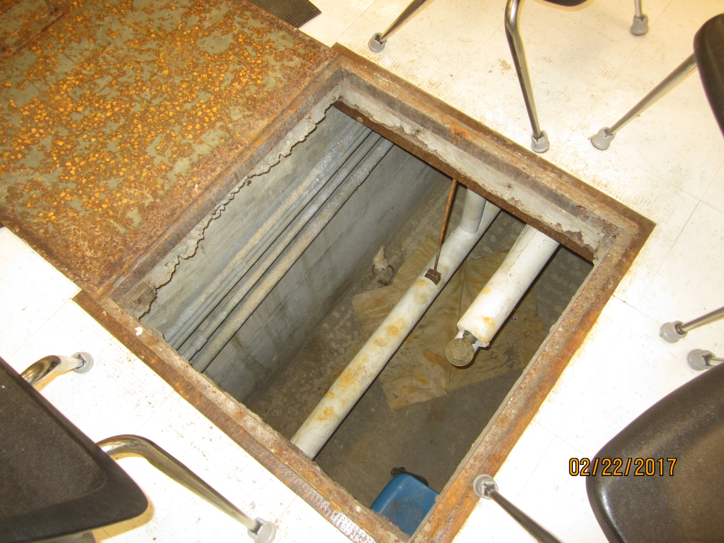

Slide 9
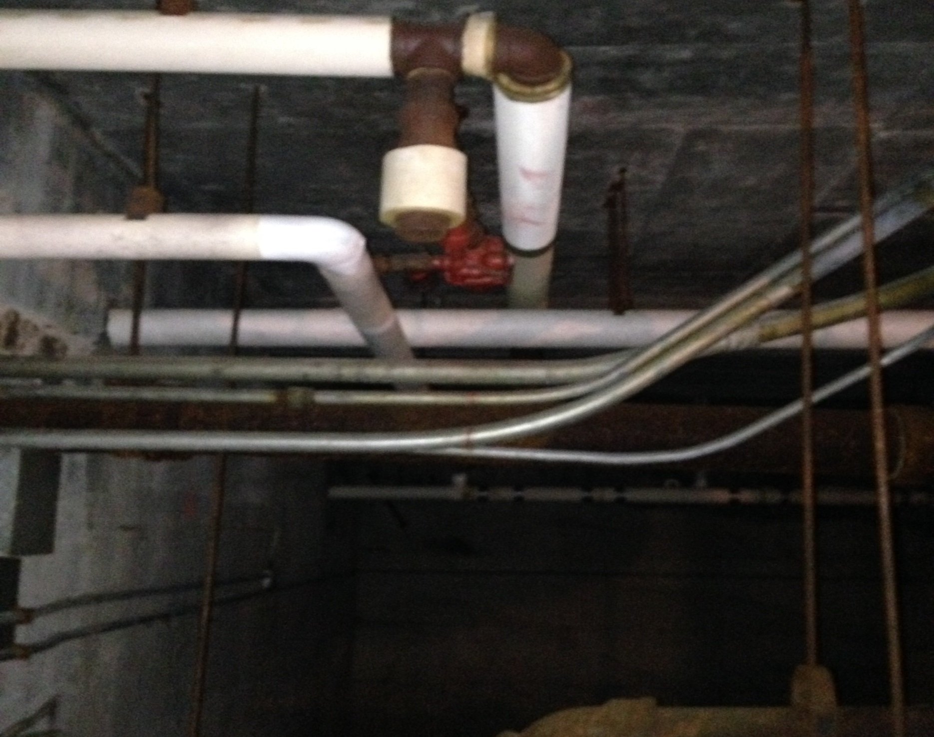

Slide 10
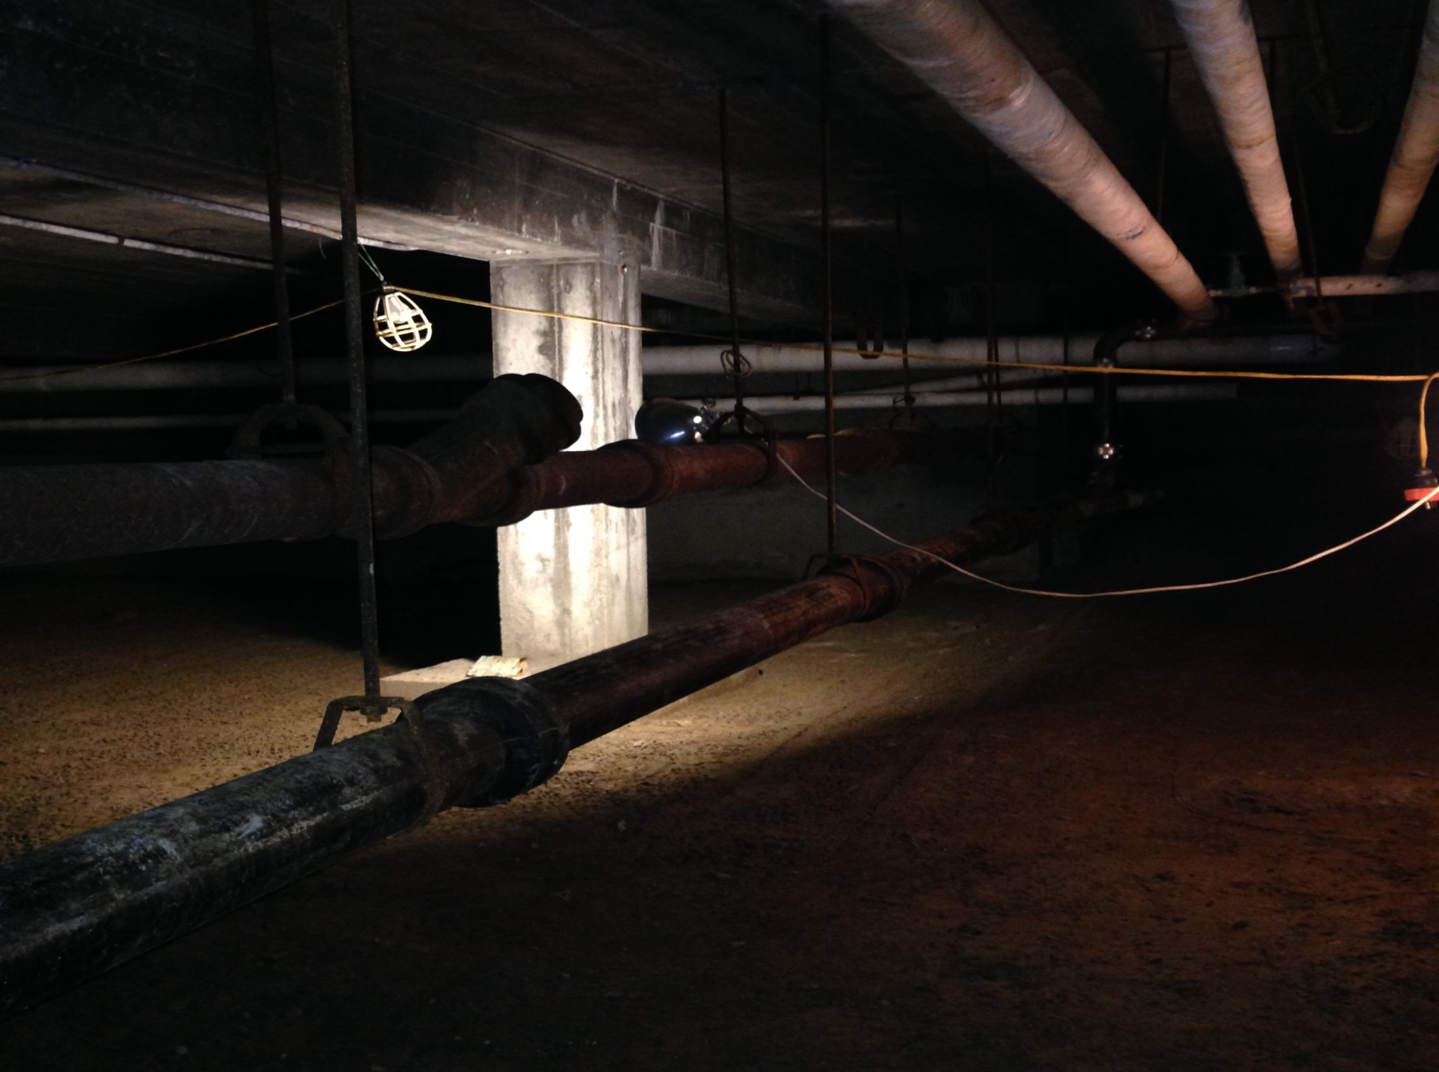

Slide 11
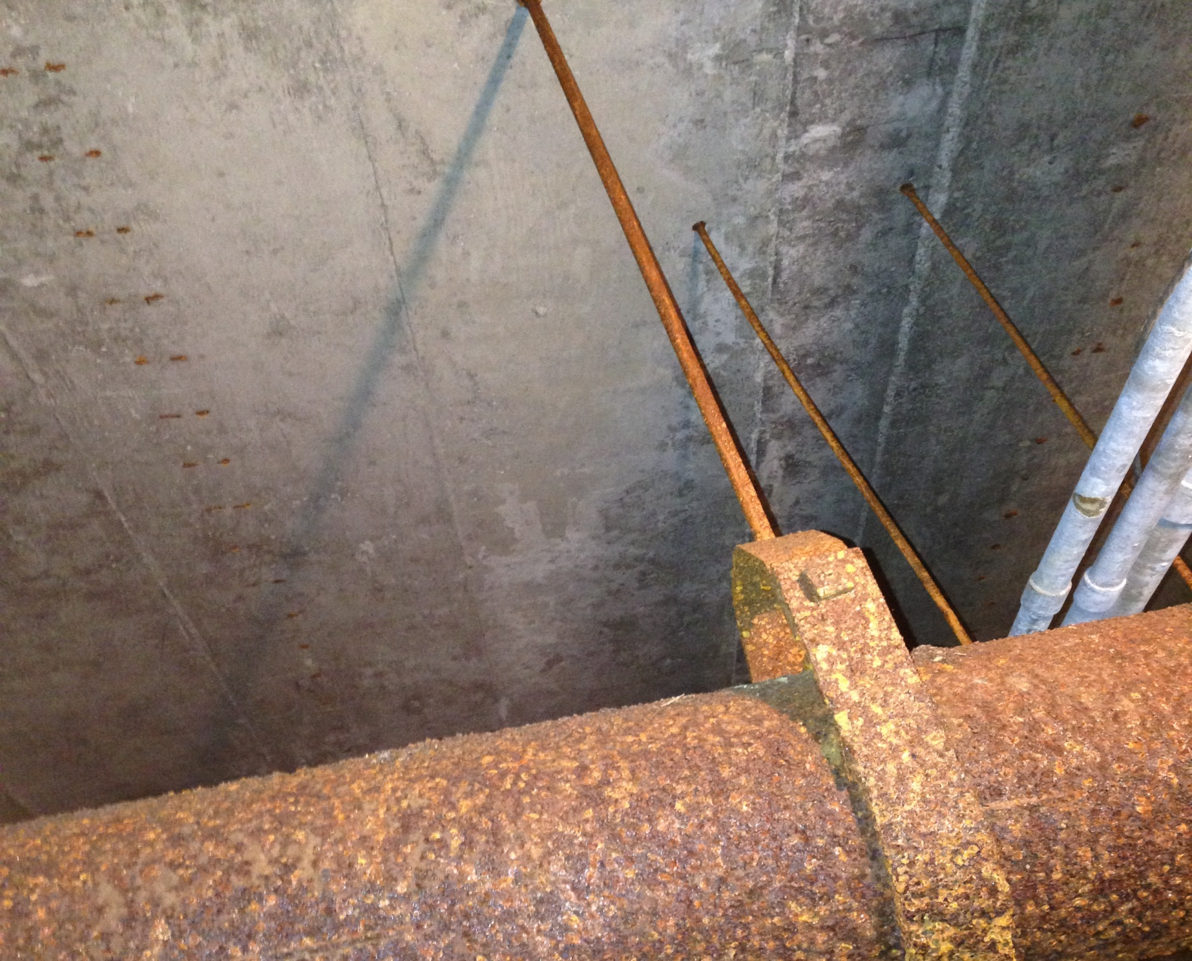

Slide 12
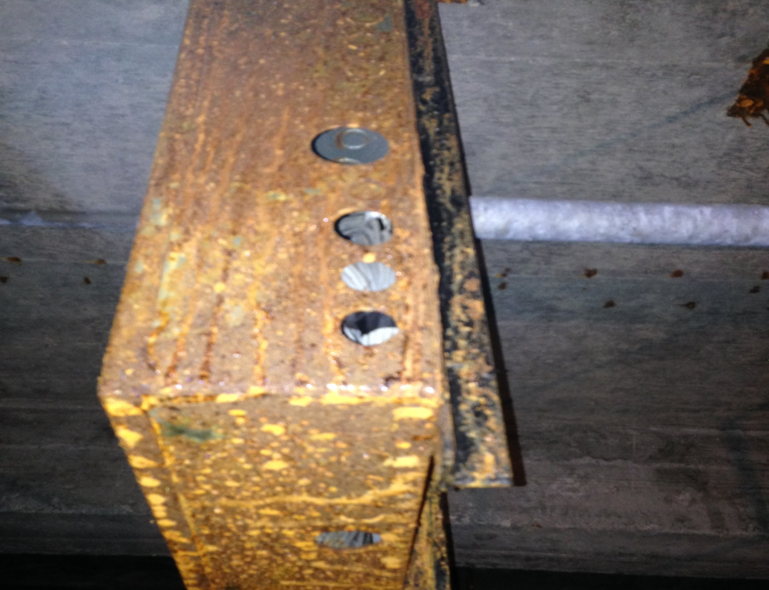

Slide 13
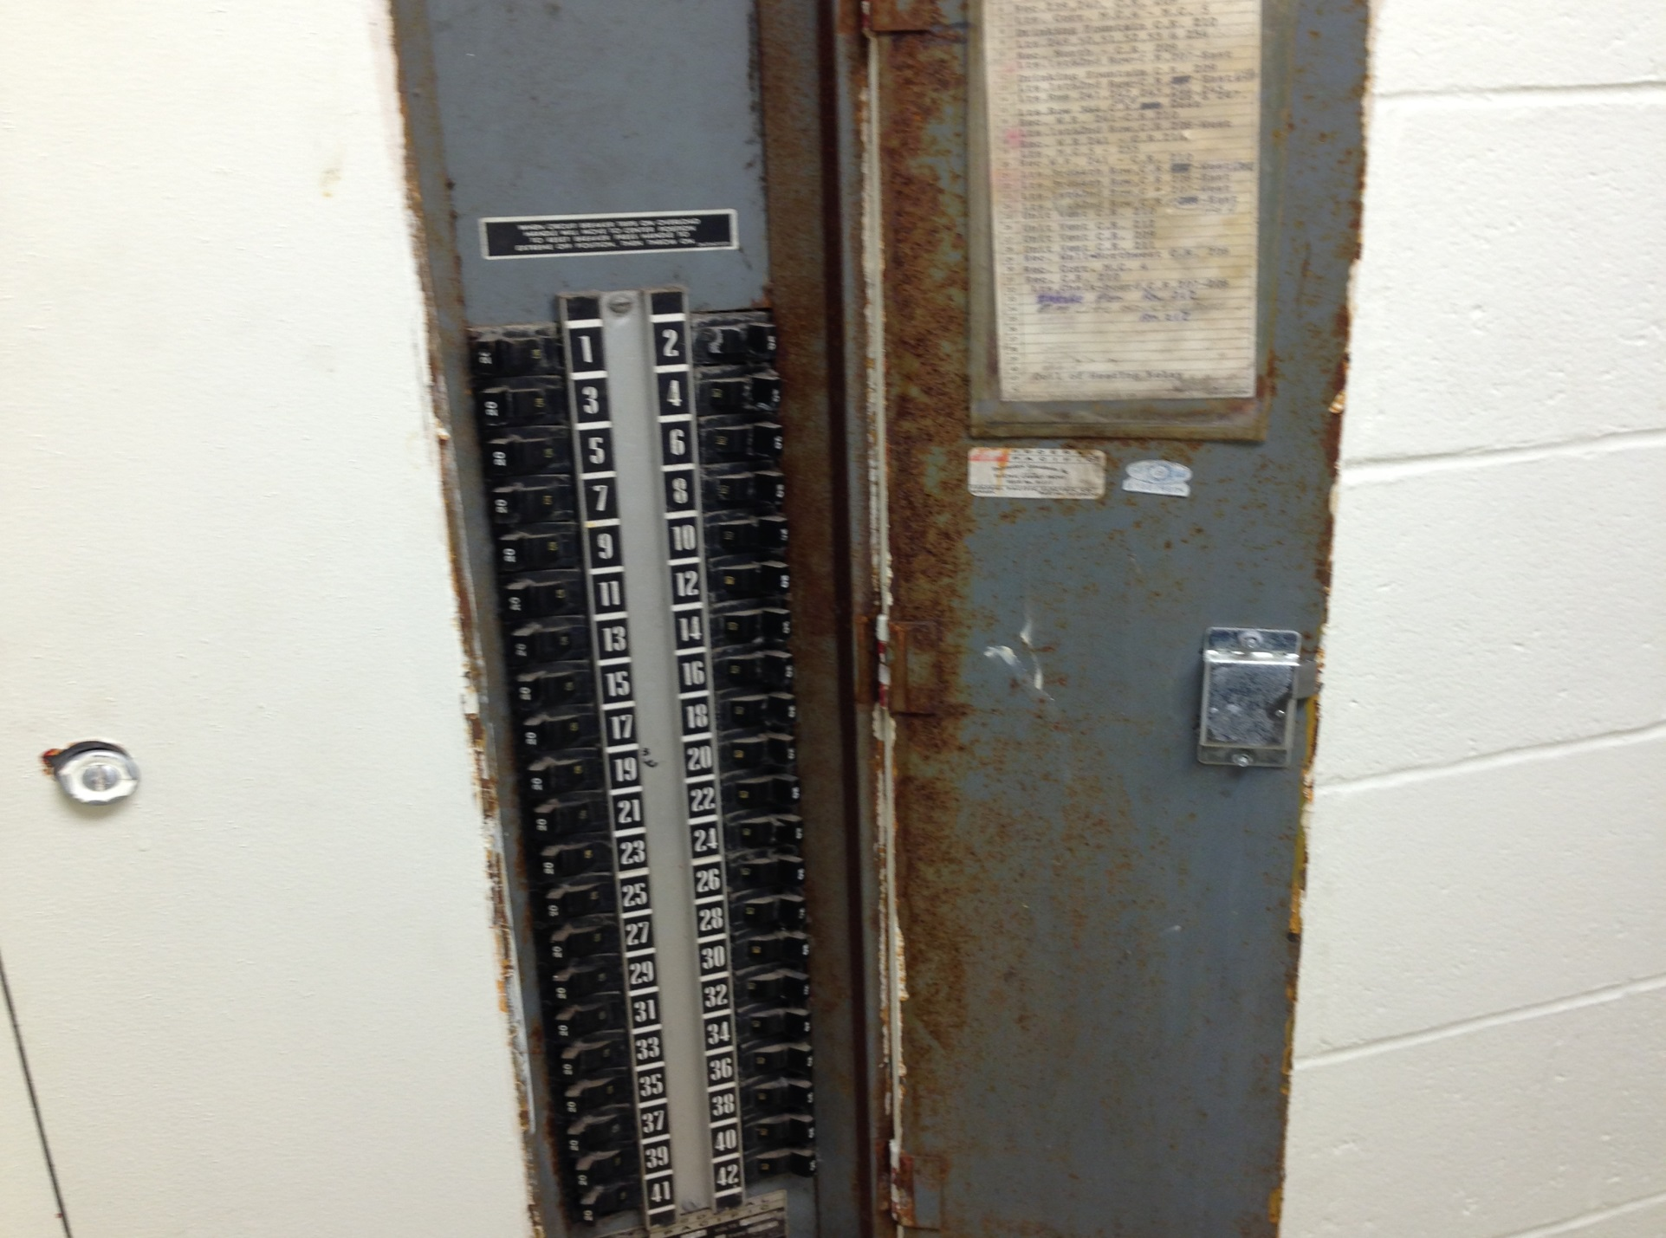

Slide 14
Cost and Difficulty Considerations
Repairs can be very expensive
  Boilers may need to be shut down or an area isolated
  Foster administration has been creative moving instruction out of impacted areas so repairs can take place
  Reroute pipe with new runs. Some pipes are not accessible as they are direct buried in concrete or belly spaces.
  Work may require contractor overtime rates over weekends, holidays, evenings

Slide 15
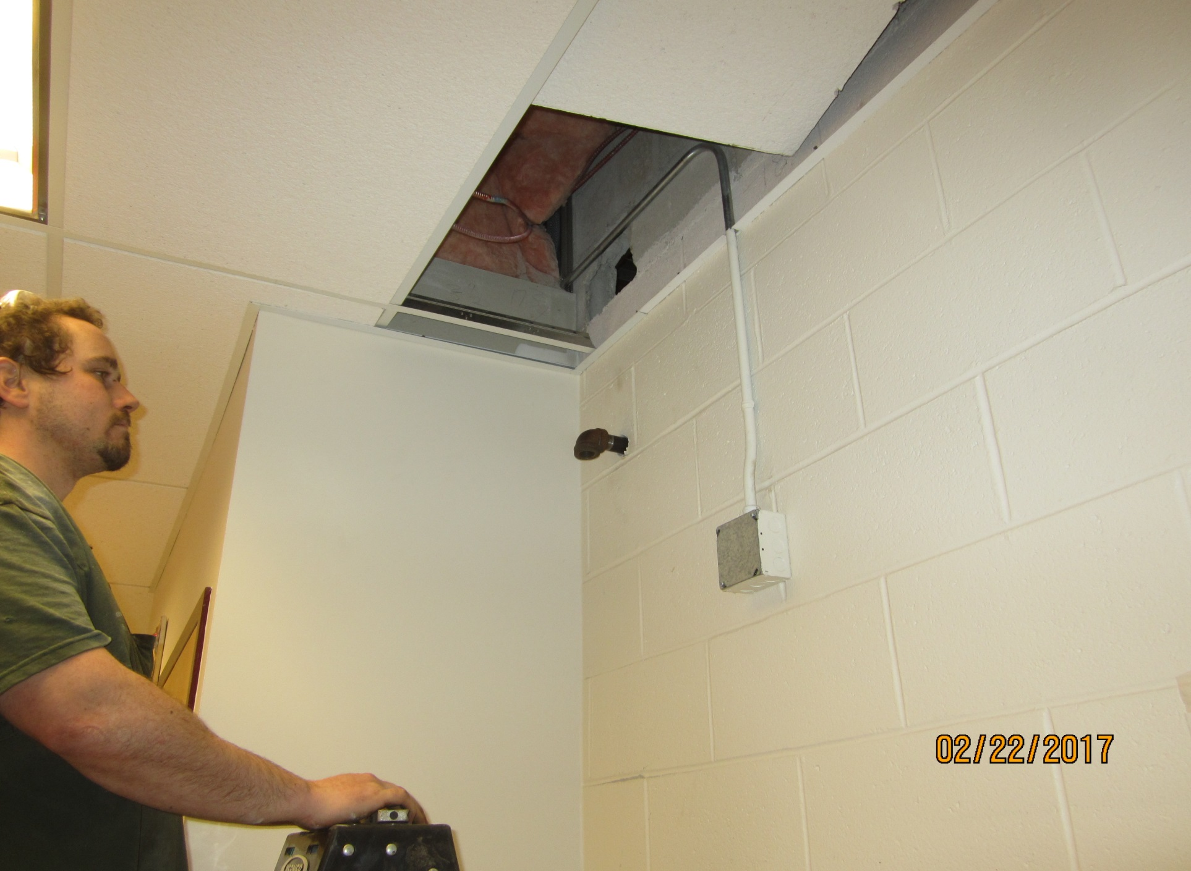

Slide 16
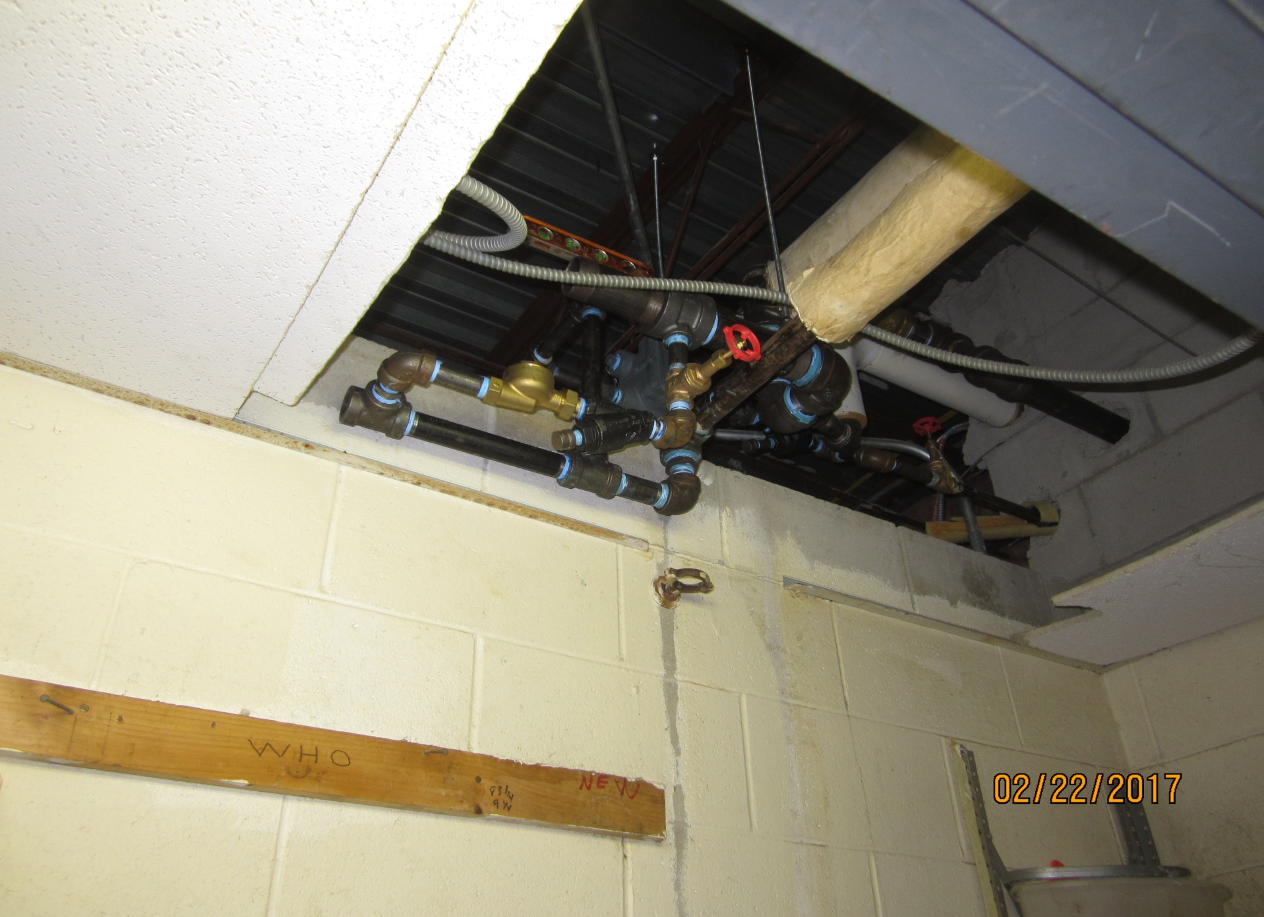

Slide 17
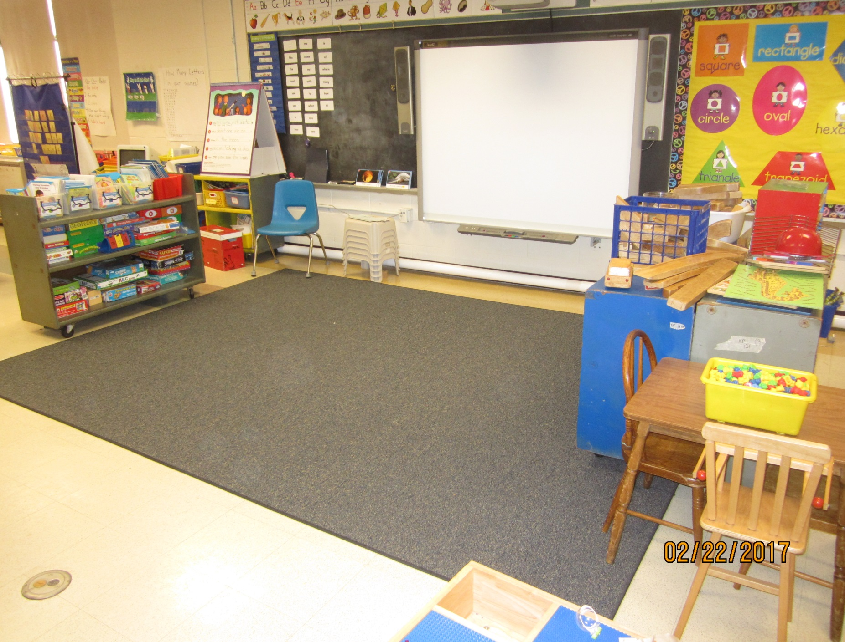

Slide 18
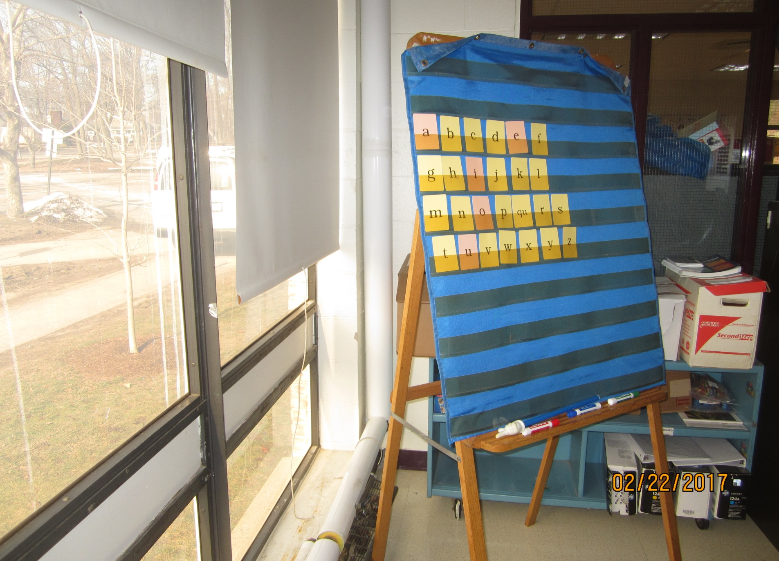

Slide 19
Cost and Difficulty Considerations(Cont)
  Leaks may go undetected in walls or under floors
  When one pipe fails, others will soon follow
    Not unlike batteries or light bulbs
    When one goes the others are not far behind
  Steam pressure will find the weak link. When one are is repaired the resumed pressure will seek the next weak point.
  Risk of a major steam distribution pipe failing which preclude use of boilers until the repair is completed. Potential for lost school days.
  Repairs may require removal of asbestos

Slide 20
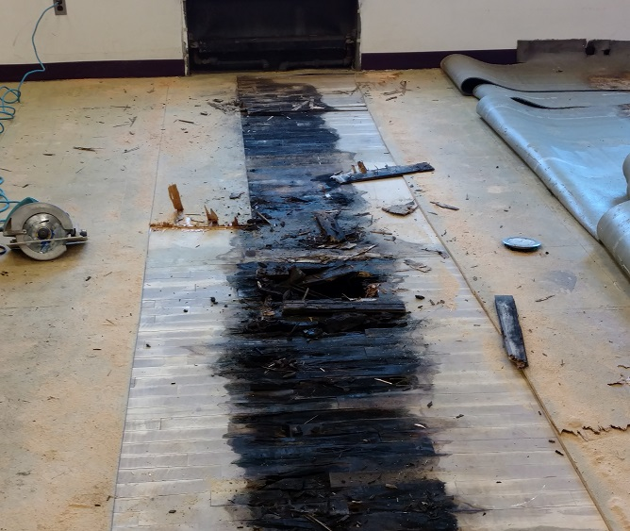

Slide 21
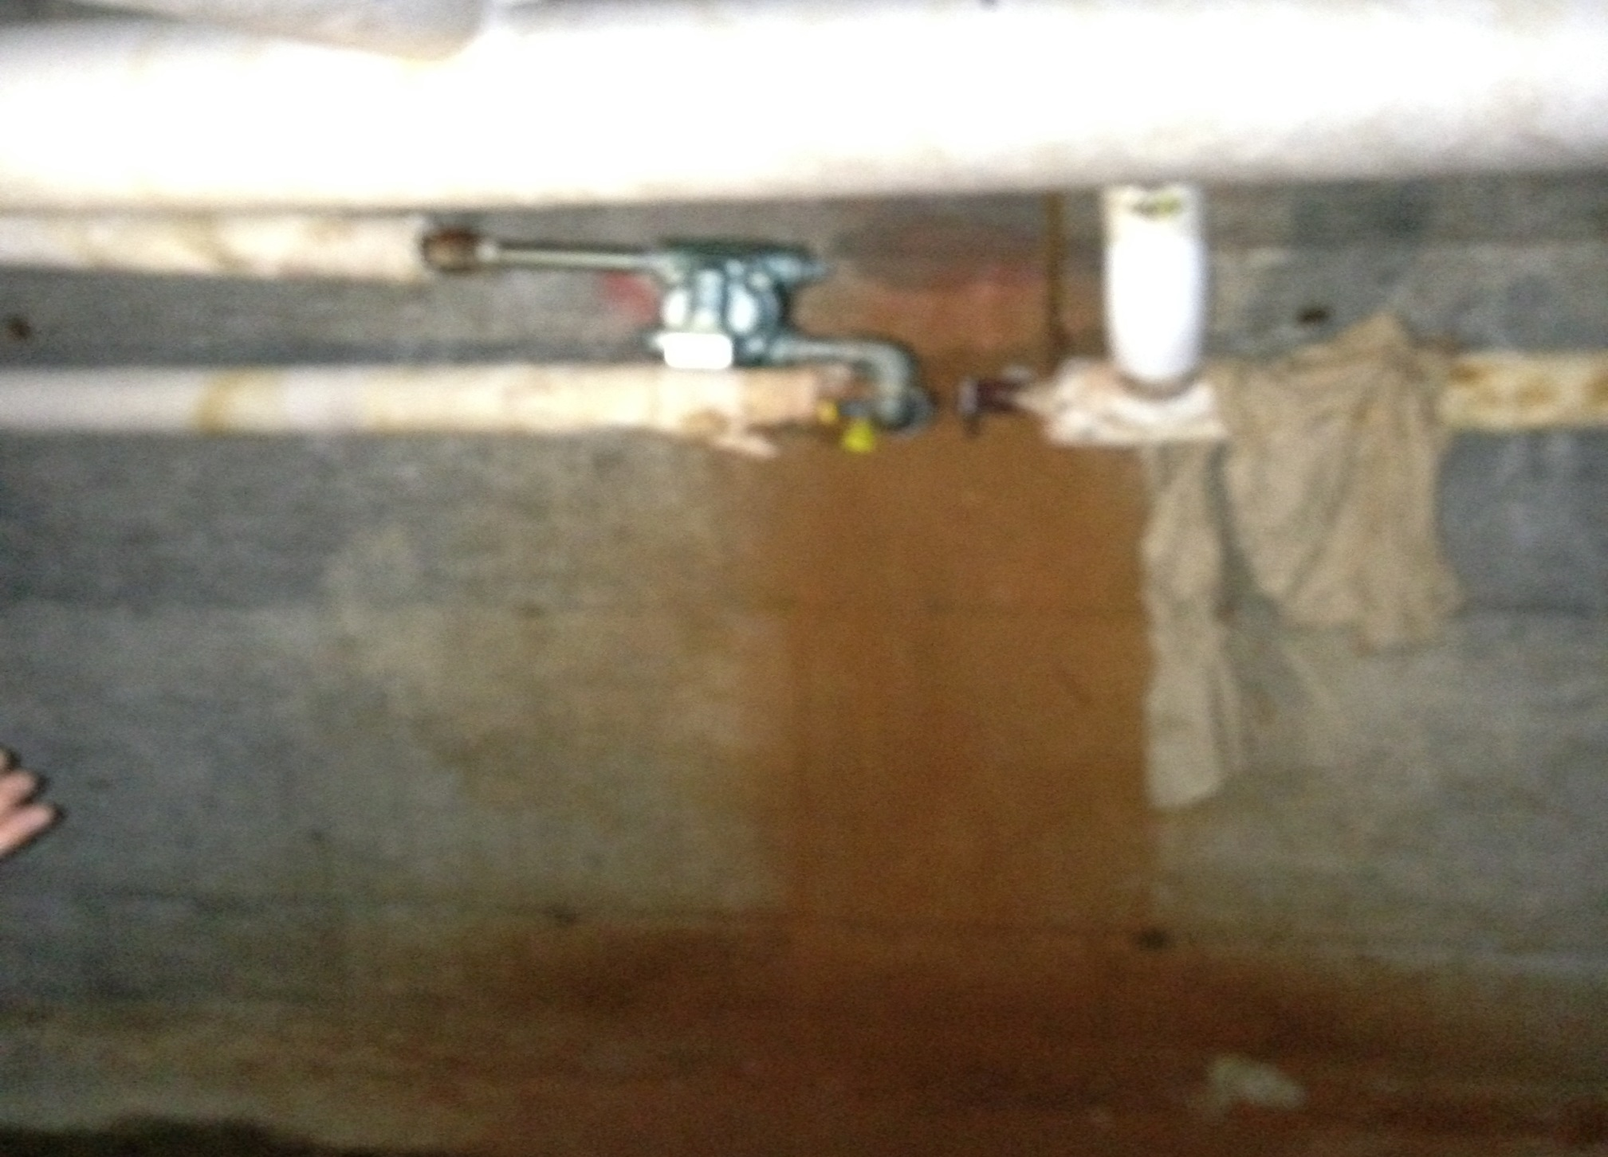

Slide 22

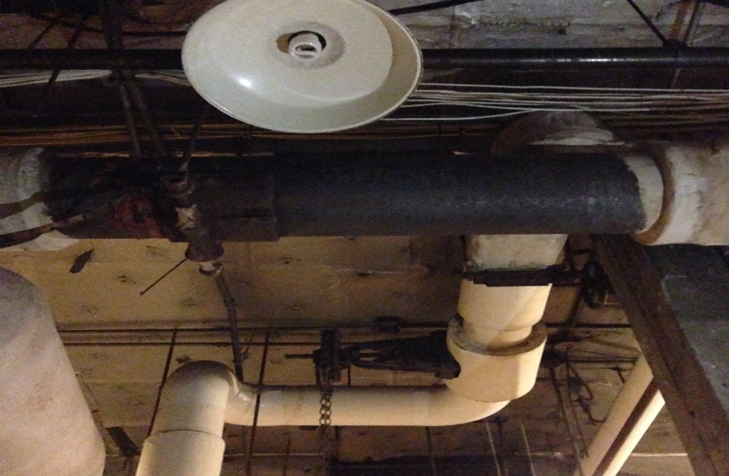

Slide 23
MSBA Statement of Interest (SOI)
An SOI is an Application with the MSBA
MSBA has two programs
  Accelerated Repair – Windows, Roofs, Boilers
  Core Program - Repairs necessary beyond the scope of accelerated repair - extensive repairs, renovations, addition/renovations, and new school construction
HPS Administration recommends filing an SOI for MSBA’s Core Program for Foster School

Slide 24
Why Now? - Urgency
Timeline for resolution is 3-5 years
For several years the School Committee has acknowledged that Foster needs a larger discussion
During 2015-2016 school year several steam leaks developed that were repaired. Fortunately the winter was mild and leaks presented very near holidays so no lost school days resulted.
At the planning meeting in September, the long timeline was discussed and serious concern about the building was expressed.
More steam pipes are failing this year in 2016-2017
Steam Pipe failures are impacting other systems

Slide 25
What are we asking?
An affirmative vote to file an Statement of Interest with the MSBA requesting an invitation into the core program for Foster School
An affirmative vote to request the Board of Selectman to a open the warrant and add a School Committee Article/s for creating a school building committee; and funding of $750,000 for a Feasibility Study for Foster contingent upon being invited into the MSBA’s core program

Slide 26
What are we requesting from the Board of Selectman?
Open the 2017 warrant to include and article/s for creating a school building committee and an appropriation of $750,000 to fund a Feasibility Study for the Foster Elementary School contingent upon an invitation into the MSBA’s core program
Provide consensus that the Board of Selectman approves of filing a Statement of Interest with the MSBA requesting an invitation into the MSBA’s core program
Between an affirmative vote tonight and April 7, 2017 the School Committee will request that the BOS sign the Statement of Interest along with the School Committee as required by the MSBA process

Slide 27
What is a Feasibility Study?
Why does it cost so much?
Beginning of a collaborative process
Form the team
Hire an Owners Project Manager (OPM)
With OPM help hire a Designer
Document Educational Program
Develop space summary
Document existing conditions
Establish design parameters
Develop and evaluate alternatives
Recommend cost effective and educationally appropriate preferred solution for MSBA Board Consideration

Slide 28
Feasibility Includes Schematic Design
Proceed into Schematic Design for the approved solution
  Develop a final design program
  Sufficient detail to establish the scope, budget and schedule for the project
Schematic Design informs Detail Design
  Both Schematic and Detail Design answer questions that need to be answered for construction documents to be produced

Slide 29
Upon Completed Feasibility
The project scope and budget is documented
MSBA prepares financial participation documents for approval by MSBA Board
MSBA Board will approve funding
Hingham will seek funding for the project from the Town
MSBA and Hingham will enter into Project Funding Agreement
Detail Design, Bidding and Construction, and Construction Administration follows

Slide 30
How was Feasibility Cost Estimated?
Use comparable school data as published by the MSBA
Estimate is based on the Median for eight Elementary Schools in MA – Various Communities $729,549 plus ~ $20,000 for site issues
Also looked at Median Cost Per Student which was higher
Also looked at Median Cost per square foot which was higher
Median Total OPM and Design Costs for a project is 15.41% (includes feasibility)

Slide 31
Other Data
SOI for the Core program is very competitive
2016 – 17 of 89 Selected
2015 – 26 of 97 Selected
2014 – 108 Applications
Number selected depends on:
  The pool selected – i.e. Elementary, Secondary
  Cost of the project – Big Building, Small Building, City or Suburb
  Anticipated MSBA funding for a particular year
    MSBA is funded by 1 penny per sales tax dollar
    Funding fluctuates with the MA economy

Slide 32
Questions???
Other Concerns???
Discussion
Thank you for your attention to this critical matter

