Slide 1
HINGHAM PUBLIC SCHOOLS January 17, 2013
FY 2014 BUDGET RECOMMENDATIONS FROM THE ADMINISTRATIVE TEAM
SUPPORT AND FACILITIES
3510, 3520, 3300, 2410, 7000, 4100-4200, Capital
Notes:
ADMINISTRATION BUDGET!!!!!!
CAPITAL WILL BE MENTIONED, BUT TAKES ANOTHER ROUTE
INITIAL SEPARATION OF SPECIAL ED/VOKE ED (MANDATED PROGRAMS) AND REGULAR ED

Slide 2
Regular Education
 |  | Budget | Budget | Budget | Increase | %
ACCOUNT | ACCOUNT TITLE | 2011-2012 | 2012-2013 | 2013-2014 | (Decrease) | Change
1100 | School Committee | $55,850 | $45,850 | $46,850 | 1,000
1200 | Administration | $832,092 | $846,853 | $867,955 | 21,102
2200 | Principals | $1,720,828 | $1,760,477 | $1,965,454 | 204,977
2300 | Teaching | $18,152,831 | $18,645,917 | $19,748,519 | 1,102,602
2350 | Professional Development | $182,100 | $185,100 | $187,000 | 1,900
2400 | Textbooks | $222,051 | $237,137 | $264,066 | 26,929
2410 | Instructional Equipment | 0 | $11,500 | $22,700 | 11,200
2450 | Instructional Technology | $561,899 | $585,947 | $672,780 | 86,833
2500 | Library | $518,918 | $537,159 | $630,498 | 93,339
2700 | Counseling | $845,810 | $876,234 | $952,457 | 76,223
2800 | Psychological Services | $321,363 | $329,464 | $339,448 | 9,983
3200 | Health Services | $447,300 | $477,485 | $492,100 | 14,615
3300 | Transportation | $1,147,496 | $1,236,613 | $1,286,998 | 50,384
3510 | Athletics | $551,887 | $595,919 | $595,890 | -29
3520 | Other Student Activity | $90,638 | $94,706 | $103,041 | 8,335
4110 | Custodial | $1,300,777 | $1,329,369 | $1,417,918 | 88,549
4120 | Heating of Buildings | $378,385 | $458,369 | $392,002 | -66,367
4130 | Utilities | $716,529 | $732,145 | $749,943 | 17,798
4210 | Maintenance of Grounds | $12,892 | $13,478 | $27,108 | 13,630
4220 | Plant Maintenance | $702,529 | $718,640 | $751,126 | 32,487
4230 | Repairs of Equipment | $109,150 | $107,370 | $106,053 | -1,317
5100 | Employee Retirement | $40,120 | $75,792 | $29,231 | -46,561
7000 | Non-Instructional Equipment | 0 | 0 | 0 | 0
 | Allowance for increases | $0 | $21,671 | $215,736 | 194,065
 | Total Regular Education | $28,911,445 | $29,923,194 | $31,864,872 | $1,941,678 | 6.49%

Slide 3
Special Education
 |  | Budget | Budget | Budget | Increase | %
ACCOUNT | ACCOUNT TITLE | 2011-2012 | 2012-2013 | 2013-2014 | (Decrease) | Change
2100B | Sped Supervision | $204,300 | $238,244 | $242,314 | 4,070
2300B | Sped Instruction | $5,128,518 | $5,457,819 | $5,692,823 | 235,004
2350B | Sped Prof. Development | $10,700 | $10,700 | $9,900 | -800
2400B | Sped Textbooks | $900 | $900 | $900 | 0
2700B | Sped Counseling | $372,524 | $388,316 | $403,720 | 15,404
2800B | Sped Psychological Services | $196,285 | $231,753 | $245,277 | 13,524
3300B | Sped Transportation | $559,305 | $627,287 | $569,553 | -57,734
9100B | Sped Prog w/other Districts | $2,977,918 | $3,543,599 | $3,400,388 | -143,211
 | Total Special Education | $9,450,450 | $10,498,618 | $10,564,875 | $66,256 | 0.63%

Slide 4
Vocational Education
 |  | Budget | Budget | Budget | Increase | %
ACCOUNT | ACCOUNT TITLE | 2011-2012 | 2012-2013 | 2013-2014 | (Decrease) | Change
3300E | Vocational Transportation | $10,400 | $10,400 | $10,400 | 0
9100E | Vocational Tuition | $62,100 | $135,108 | $127,892 | -7,216
 | Total Votech | $72,500 | $145,508 | $138,292 | -$7,216 | -4.96%
 | Total Proposed Budget | $38,434,395 | $40,567,321 | $42,568,038 | $2,000,718 | 4.93%

Slide 5
FY 14 Athletics (3510)
Athletics | Proposed | Proposed | $$$ | %
 | FY 13 | FY 14 | Change | Change
Professional Salaries | 395,569 | 406,825 | 11,256 | 2.85%
Other Salaries | 90,752 | 98,570 | 7,819 | 8.62%
Contracted Services | 105,789 | 110,799 | 5,010 | 4.74%
Materials and Supplies | 73,045 | 73,448 | 403 | 0.55%
Other Expenses | 154,764 | 166,248 | 11,484 | 7.42%
Revolving Fund Usage | -224,000 | -260,000 | -36,000 | 16.07%
 | 595,919 | 595,890 | -29 | 0.00%
Contractual increases
Two new Asst. coaches
Boys /Girl Cross Country
Sailing
Dance Moved to Athletics
Increase for Title IX Administrative Support
Offset – Increased to cover increases and new positions

Slide 6
FY 14 Student Activities (3520)
Student Activities | Proposed | Proposed | $$$ | %
 | FY 13 | FY 14 | Change | Change
Professional Salaries | 139,795 | 153,090 | 13,295 | 9.51%
Transportation | 2,500 | 2,500 | 0 | 0.00%
Materials and Supplies | 11,200 | 11,200 | 0 | 0.00%
Offsets | -58,789 | -69,949 | -11,160 | 18.98%
 | 94,706 | 96,841 | 2,135 | 2.25%
Contractual Increases on scheduled advisor stipends.
Dance moved to Athletics
Additional MS Stipends offset by MS Activity Fee
New Global Citizen Certificate Program
Offsets include Drama Club, Student Parking, and increase in MS Activity Fee.

Slide 7
FY 14 Transportation (3300)
Transportation |  | Proposed | $$$ | %
 | FY 13 | FY 14 | Change | Change
Secretarial Salaries | 31,230 | 31,847 | 617 | 1.97%
Other Salaries | 619,401 | 647,239 | 27,838 | 4.49%
Contracted Services | 18,000 | 20,000 | 2,000 | 11.11%
Fuel and Supplies | 148,950 | 152,560 | 3,610 | 2.42%
Other Expenses | 12,800 | 13,500 | 700 | 5.47%
Leasing | 414,232 | 429,852 | 15,620 | 3.77%
Offset - MS Activity | -8,000 | -8,000 | 0 | 0.00%
 | 1,236,613 | 1,286,998 | 50,384 | 4.07%
Contractual increases in the Allowance Account. Needs to be negotiated for FY 14
Enrollment Driven need for an additional bus and driver
Fuel –Town wide fuel assumption rate up slightly. Based on Actual 2012 Gallons seasonally adjusted.
Lease includes 1 new bus

Slide 8
Instructional Equipment (2410)
 |  | Proposed | $$$ | %
 | FY 13 | FY 14 | Change | Change
Non Capital Equipment | 0 | 6,000 | 6,000 | #DIV/0!
Equipment Lease (Copier) | 9,500 | 16,700 | 7,200 | 75.79%
Biology Forensic Science | 2,000 | 0 | -2,000 | -100.00%
 | 11,500 | 22,700 | 11,200 | 97.39%
Copier leases with three years no maintenance funded by decreased maintenance charges
Leased two additional machines in FY 13
Non Capital Equipment -allowance for Principals to authorize the purchase of small equipment during the year

Slide 9
Non-Instructional Equipment (7000)
Includes maintenance equipment such as vacuums, scrubbers, desk movers, mowers, leaf vacuums, and other power equipment
Funded through Building Rental and Field Rental Fees
Increases productivity
 |  | Proposed | $$$ | %
 | FY 13 | FY 14 | Change | Change
Equipment | 8,850 | 15,000 | 6,150 | 69.49%
Offset | -8,850 | -15,000 | -6,150 | 69.49%
 | 0 | 0 | 0 | 0

Slide 10
Custodial (4110)
 |  | Proposed | $$$ | %
 | FY 13 | FY 14 | Change | Change
Salaries | 1,146,019 | 1,221,368 | 75,349 | 6.57%
Overtime | 75,000 | 85,000 | 10,000 | 13.33%
Supplies | 97,850 | 101,050 | 3,200 | 3.27%
Other | 10,500 | 10,500 | 0 | 0.00%
 | 1,329,369 | 1,417,918 | 88,549 | 6.66%
New Custodial Supervisor/Maintenance Back up
Salaries at FY 13. Contract needs to be negotiated. Step increases included.
OT increase for custodial project work
Custodial supplies increased by 3+% based on government reported inflation data.
Notes:
Salaries:
The net increase in the salary line of $ 28,592 a 2% across the board increase for custodians and the addition of a stipend $2,500 for a School Dude work order system manager to provide training and support to the field and administration for using the system. The purchase and implementation of the system also helped Hingham receive a more favorable reimbursement rate from the MSBA for the New Middle School. The overtime budget is held flat year over year and includes amounts for school event coverage, training, security and other building needs.
Supplies and Materials:
Supply accounts which include all cleaning products, floor care products, bathroom supplies, hand sanitizers, light bulbs, etc. are proposed at 3% increase, based on vendor inquiry. The CPI index and Price Deflator Index for state and local government for the third quarter of 2011 are at 2.6 and 3.6 respectively.

Slide 11
Heating of Buildings (4120)
 |  | Proposed | $$$ | %
 | FY 13 | FY 14 | Change | Change
Oil | 233,305 | 204,771 | -28,534 | -12.23%
Gas | 211,075 | 208,892 | -2,183 | -1.03%
Electric | 88,989 | 85,044 | -3,945 | -4.43%
OffSets | -75,000 | -75,000 | 0 | 0.00%
 | 458,369 | 423,707 | -34,662 | -7.56%
Budget request down from FY 13 by $34K
Projection based on adjusted FY 12 usage and town wide price assumption for Oil, Gas and Electricity
Offsets from Building Rentals, Field Use, Continuing Ed, Drivers Ed and KIA.
New Forecasting Methodology (Average degree days to adjust previous years usage)
PRS is all electric

Slide 14
Utilities (4130)
Gas services for Kitchens, etc.
Service held flat year over year.
Water and sewer increase due to sewer increase and FY 13 budget error
Electricity forecast based on adjusted 12 actuals using degree days
 |  | Proposed | $$$ | %
 | FY 13 | FY 14 | Change | Change
Gas | 6,023 | 5,246 | -777 | -12.91%
Water and Sewer | 57,138 | 76,184 | 19,046 | 33.33%
Electricity | 644,984 | 644,514 | -470 | -0.07%
Telephone | 24,000 | 24,000 | 0 | 0.00%
 | 732,145 | 749,943 | 17,798 | 2.43%

Slide 16
Grounds Maintenance (4210)
 |  | Proposed | $$$ | %
 | FY 13 | FY 14 | Change | Change
Summer Help | 4,478 | 9,108 | 4,630 | 103.39%
Contracted Services | 36,500 | 51,500 | 15,000 | 41.10%
Supplies and Materials | 9,000 | 13,000 | 4,000 | 44.44%
Offset | -36,500 | -46,500 | -10,000 | 27.40%
 | 13,478 | 27,108 | 13,630 | 101.13%
Dedicated grounds maintenance person charged in Athletics. DPW does larger school grounds.
One New Summer Hire for Grounds
Field Maintenance generally is contracted out and funded through Field Use Revolving
Additional $15K for Asphalt – Asphalt repairs are not a capital expense. Included here in operating budget
Supplies and materials for elementary playgrounds and fields.

Slide 17
Plant Maintenance (4220)
 |  | Proposed | $$$ | %
 | FY 13 | FY 14 | Change | Change
Salaries | 32,914 | 32,914 | 0 | 0.00%
Other Salaries | 288,857 | 297,393 | 8,536 | 2.96%
Contracted Services | 315,200 | 339,100 | 23,900 | 7.58%
Supplies | 72,000 | 72,000 | 0 | 0.00%
Fuel for Maintenance | 9,669 | 9,720 | 51 | 0.53%
 | 718,640 | 751,126 | 32,487 | 4.52%
Salary at FY 13 rates. Contract needs to be negotiated. Amounts included in the allowance.
Funding for Two New Summer Help
$10.5K increase for non capital projects
Funding for state mandated lift upgrades - $10K
Funding for state mandated fuel operator regulations $3.4K

Slide 18
Repair of Equipment (4230)
 |  | Proposed | $$$ | %
 | FY 13 | FY 14 | Change | Change
Copiers/Duplicators | 38,000 | 36,000 | -2,000 | -5.26%
Other | 35,200 | 35,200 | 0 | 0.00%
Network Mgr Allocation | 34,170 | 34,853 | 683 | 2.00%
 | 107,370 | 106,053 | -1,780 | -1.66%
Copier maintenance charges reduced due to leasing some new equipment.
Other includes Repair of Instructional equipment such as Audiovisual, Music, Foreign Language, Computers, Health, etc.
Network Management allocation for tech support at Central office and phone system across the system

Slide 19
Administration’s Capital Request By School and Type FY 2014

Slide 20
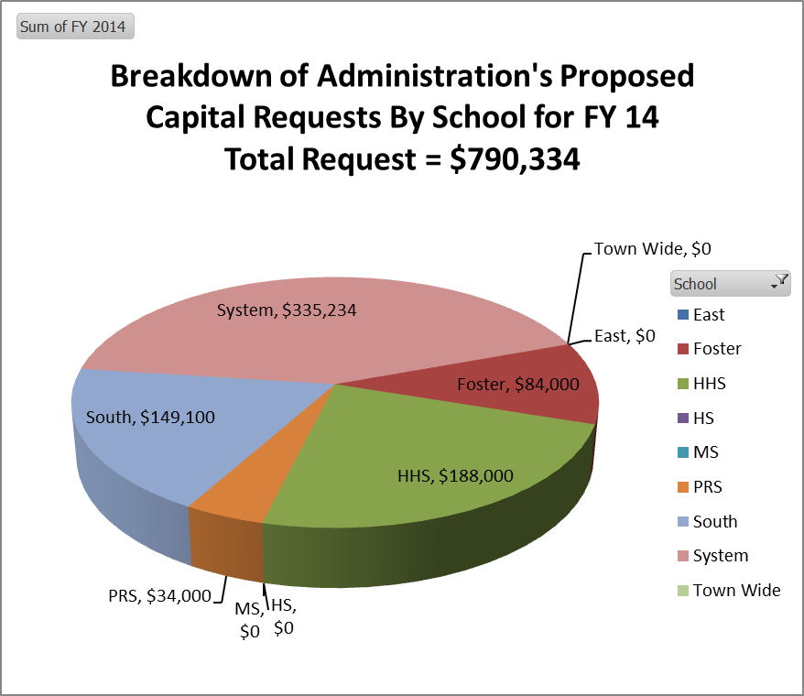

Slide 21
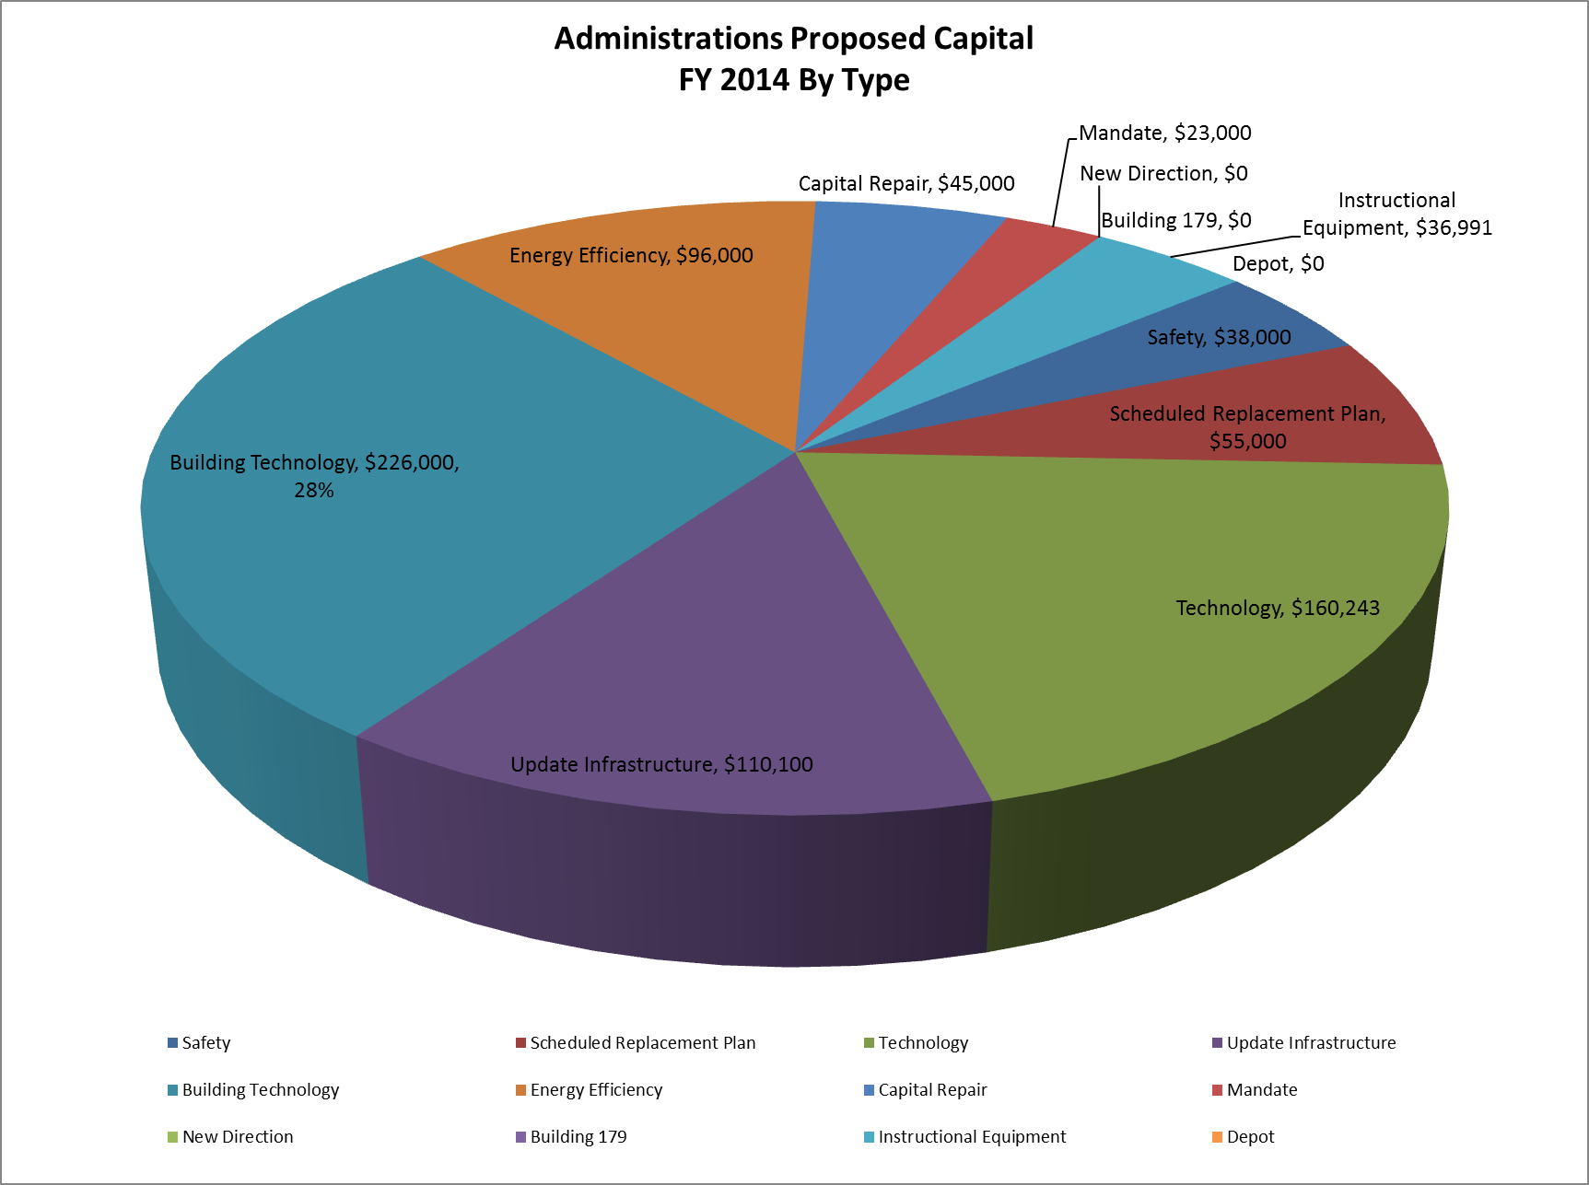

Slide 22
2014 Capital Breakdown By Type (page 1 of 3)
Type | Project | School | Total
Building Technology | Energy Management System - DDC Repair. | Foster | $10,000
 |  |  | $10,000
 | South School Energy Management System | South | $136,000
 |  |  | $136,000
 | Upgrade software and parts for energy management heating & ventilation system | HHS | $80,000
 |  |  | $80,000
Building Technology Total |  |  | $226,000
Capital Repair | Roof Repairs all Buildings | System | $25,000
 |  |  | $25,000
 | Trace down and remediate odor in the science Wing | HHS | $20,000
 |  |  | $20,000
Capital Repair Total |  |  | $45,000
Energy Efficiency | High School Efficient Lighting Projects - Moved to 2013 as a piece of the $50,000 school committee reduction | HHS | $55,000
 |  |  | $55,000
 | Install lighting in the main office, conference room, and administrative offices, and Gym (efficiency Upgrade postponed from FY 13) | PRS | $10,000
 |  |  | $10,000
 | Replace Foster Water Cooled Refrigeration Compressor w /air cooled compressor. | Foster | $16,000
 |  |  | $16,000
 | Update lighting in: Kitchen, LMC, Rm. 207, Rm. 103, Rm. 003, Rm. 124C, Rm. 124D and Cafeteria Upgrade from FY 13 List | Foster | $15,000
 |  |  | $15,000
Energy Efficiency Total |  |  | $96,000

Slide 23
2014 Capital Breakdown By Type (page 2 of 3)
Type | Project | School | Total
Instructional Equipment | Instructional Equipment | System | $36,991
 |  |  | $36,991
Instructional Equipment Total |  |  | $36,991
Mandate | Elevator Major repair | HHS | $23,000
 |  |  | $23,000
Mandate Total |  |  | $23,000
Safety | Additional Surveillance Cameras (security) | System | $8,000
 |  |  | $8,000
 | Replace and repair Pleasant Street entrance broken side walk | HHS | $10,000
 |  |  | $10,000
 | Updated Radios for all Schools (Security) | System | $10,000
 |  |  | $10,000
 | Emergency Lights - Additional Battery Operated cans in lieu of Generator | System | $10,000
 |  |  | $10,000
Safety Total |  |  | $38,000
Schedule Replacement Plan | Copiers | System | $25,000
 |  |  | $25,000
 | Replace School Transportation Van (1 Each) | System | $30,000
 |  |  | $30,000
Schedule Replacement Plan Total |  |  | $55,000

Slide 24
2014 Capital Breakdown By Type (page 3 of 3)
Type | Project | School | Total
Technology | Technology Capital Requests | System | $160,243
 |  |  | $160,243
Technology Total |  |  | $160,243
Update | Gate House Renovations | System | $30,000
 |  |  | $30,000
 | Heating Fix for Room Art Room | Foster | $5,000
 |  |  | $5,000
 | Resurface Outdoor Basketball courts Re-Surface | Foster | $10,000
 |  |  | $10,000
 | Restore Play shed at Foster | Foster | $28,000
 |  |  | $28,000
 | Plymouth River Play shed Roof | PRS | $24,000
 |  |  | $24,000
 | Replace carpet in library and Room 120 | South | $13,100
 |  |  | $13,100
Update Total |  |  | $110,100
Grand Total |  |  | $790,334

Slide 25
Next Steps
Special Ed Budget Detail
January 24, 2013 General Discussion
January 31, 2013 Joint meeting of Selectmen and Advisory at Town Hall
Questions????

