Slide 1
Annual Training
September 2022

Slide 2
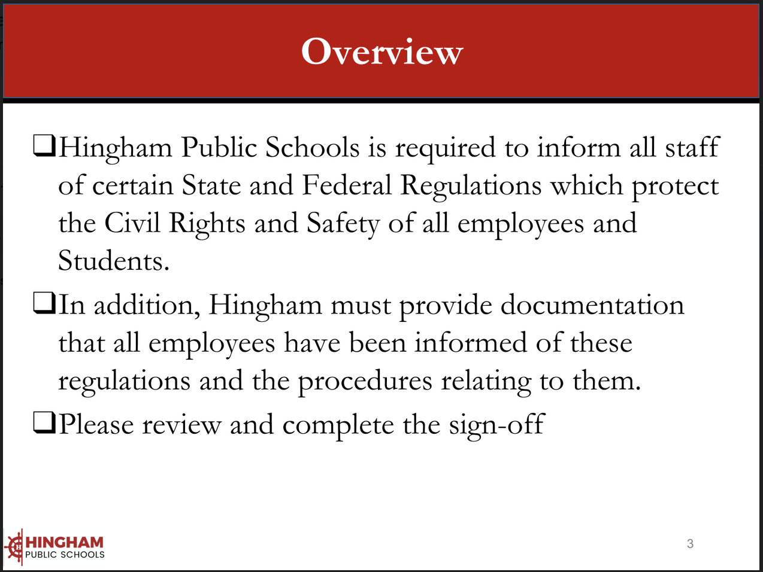

Slide 3
Click here to access the full document of the Annual Training Packet.

Slide 11
Heather Rodriguez, Director of School Counseling
Suzanne Vinnes, Director of Student Services
Aisha Oppong, Director of Business

Slide 35
Hingham Public Schools has designated the Assistant Superintendent of Schools as the district’s Foster Care point of contact.

Slide 41
Please be sure that you read and understand HPS Policies and Procedures Related to. . .

Slide 42
Annual Training Sign Off
Please complete the Google form below to certify that you have read and understood the Civil Rights Training packet, the policies contained in the packet, and the Annual Training presentation materials:
https://forms.gle/scFvYjGYkFAK37ij8

